Slide 1
Tree Diagrams
Question: Given there’s 5 red balls and 2 blue balls. What’s the probability that after two picks we have a red ball and a blue ball?
Bro Tip: Note that probabilities generally go on the lines, and events at the end.
After first pick, there’s less balls to choose from, so probabilities change.
4
6
?
R
?
5
7
R
?
B
2
6
5
6
R
?
2
7
?
B
1
6
B
?

Slide 2
Tree Diagrams
Question: Give there’s 5 red balls and 2 blue balls. What’s the probability that after two picks we have a red ball and a blue ball?
We multiply across the matching branches, then add these values.
4
6
R
5
7
R
5
21
B
?
2
6
5
6
R
5
21
?
2
7
B
1
6
B
10
21
?
P(red and blue) =

Slide 3
Summary
...with replacement:
The item is returned before another is chosen. The probability of each event on each trial is fixed.
...without replacement:
The item is not returned.
Total balls decreases by 1 each time.
Number of items of this type decreases by 1.
Note that if the question doesn’t specify which, e.g. “You pick two balls from a bag”, then PRESUME WITHOUT REPLACEMENT.

Slide 4
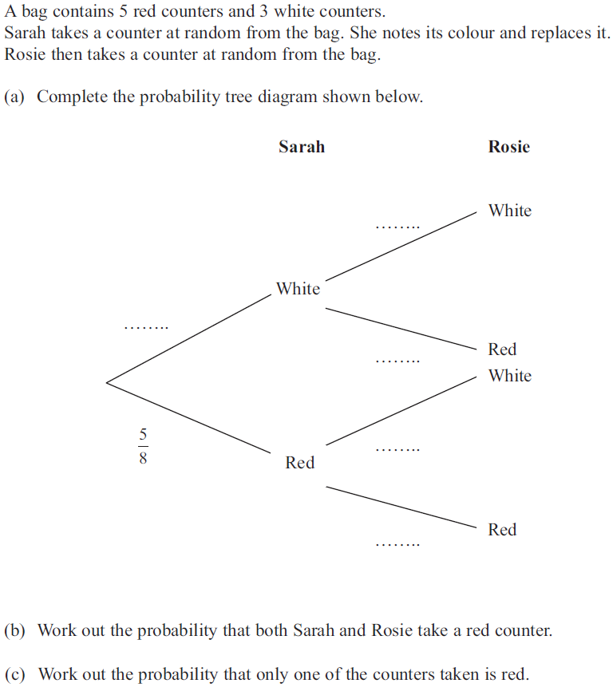


Example (on your sheet)
?
3
8
?
3
8
?
5
8
?
$$\frac{5}{8}×\frac{5}{8}=\frac{25}{64}$$
?
3
8
?
5
8
?
$$\left(\frac{3}{8}×\frac{5}{8}\right)+\left(\frac{5}{8}×\frac{3}{8}\right) \\ =\frac{15}{32}$$

Slide 5
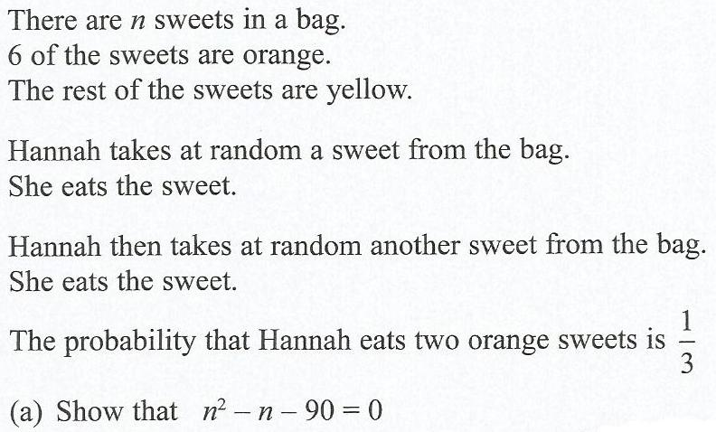

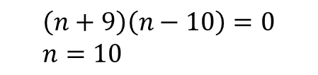
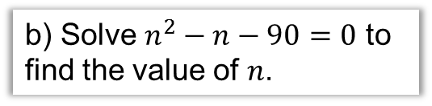
Algebraic Probability Questions
This question famously made national news…
?
b) Solve $n^{2}−n−90=0$ to find the value of $n$.
Probability both orange:
$$\frac{6}{n}×\frac{5}{n−1}=\frac{1}{3}$$
$$\frac{30}{n(n−1)}=\frac{1}{3}$$
$$90=n\left(n−1\right) \\ n^{2}−n=90 \\ n^{2}−n−90=0$$
?
$$\left(n+9\right)\left(n−10\right)=0 \\ n=10$$
‘Cross multiply’

Slide 6
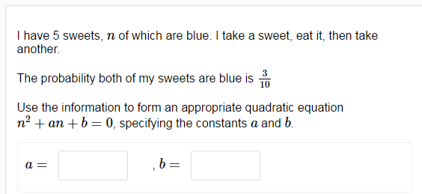
Test Your Understanding
From DrFrostMaths homework platform…
-1
-6
?
?

Slide 7
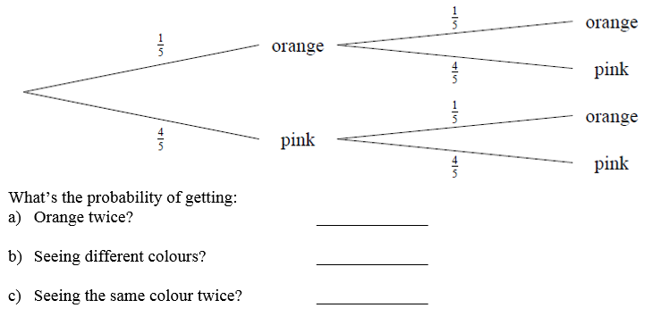


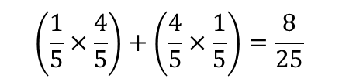
Question 1
?
$$\frac{1}{5}×\frac{1}{5}=\frac{1}{25}$$
?
$$\left(\frac{1}{5}×\frac{4}{5}\right)+\left(\frac{4}{5}×\frac{1}{5}\right)=\frac{8}{25}$$
$$1−\frac{8}{25}=\frac{17}{25}$$
?

Slide 8
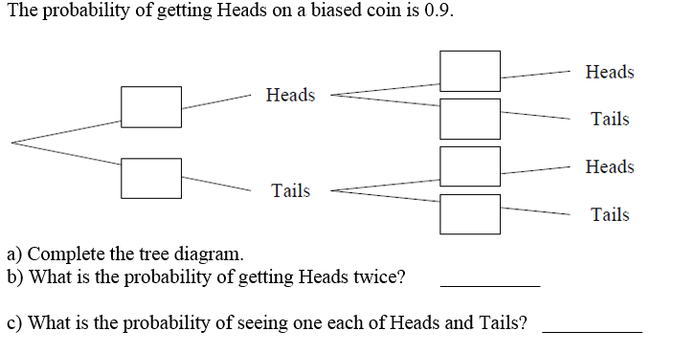








Question 2
?
$$0.9$$
?
$$0.9$$
$$0.1$$
?
$$0.9$$
$$0.1$$
$$0.1$$
?
$${0.9}^{2}=0.81$$
?
$$2×0.1×0.9=0.18$$

Slide 9
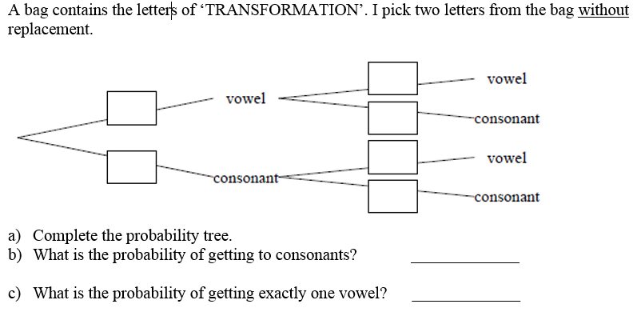





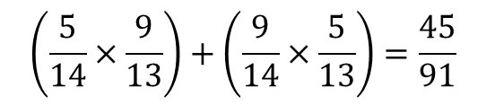

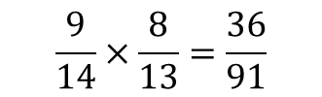
Question 3
?
$$\frac{4}{13}$$
$$\frac{5}{14}$$
?
$$\frac{9}{13}$$
$$\frac{5}{13}$$
$$\frac{9}{14}$$
?
$$\frac{8}{13}$$
$$\frac{9}{14}×\frac{8}{13}=\frac{36}{91}$$
?
two consonants?
$$\left(\frac{5}{14}×\frac{9}{13}\right)+\left(\frac{9}{14}×\frac{5}{13}\right)=\frac{45}{91}$$
?

Slide 10
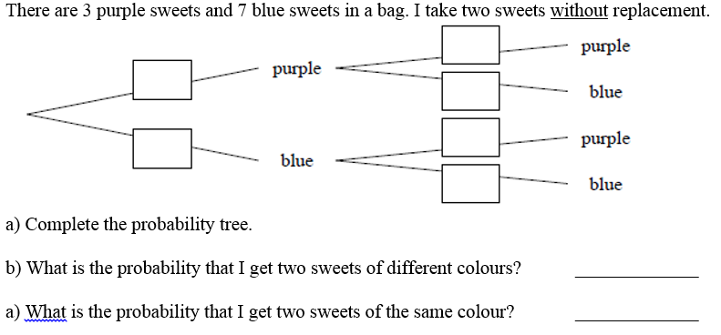







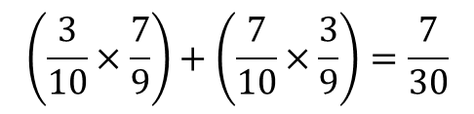
Question 4
$$\frac{2}{9}$$
?
$$\frac{3}{10}$$
?
$$\frac{7}{9}$$
$$\frac{3}{9}$$
$$\frac{7}{10}$$
?
$$\frac{6}{9}$$
$$\left(\frac{3}{10}×\frac{7}{9}\right)+\left(\frac{7}{10}×\frac{3}{9}\right)=\frac{7}{30}$$
?
?
$$1−\frac{7}{30}=\frac{23}{30}$$

Slide 11
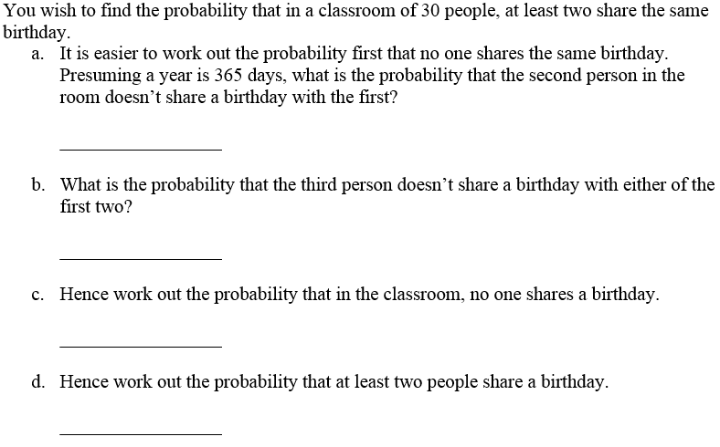

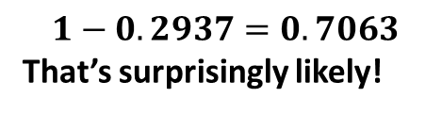
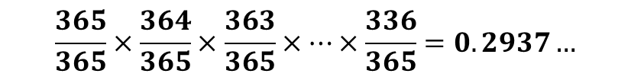

Question 5 – “The Birthday Paradox”
$$\frac{364}{365}$$
?
$$\frac{363}{365}$$
?
$$\frac{365}{365}×\frac{364}{365}×\frac{363}{365}×…×\frac{336}{365}=0.2937…$$
?
$$1−0.2937=0.7063$$
That’s surprisingly likely!
?

Slide 12
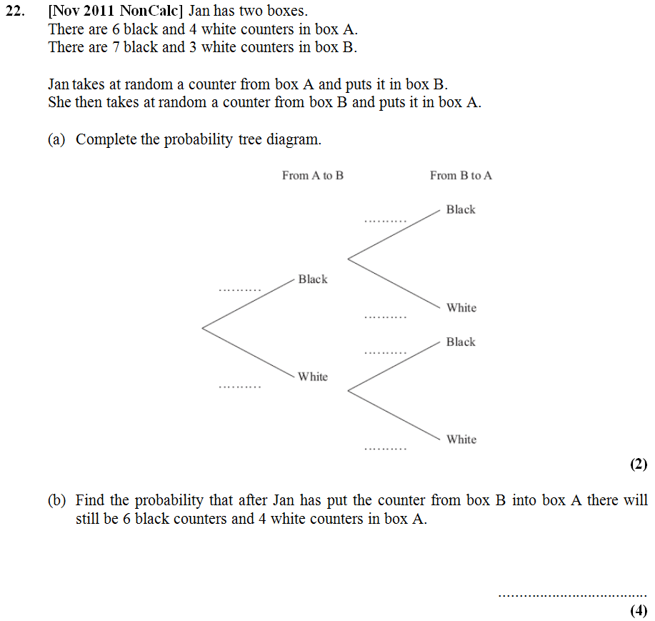
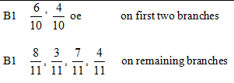
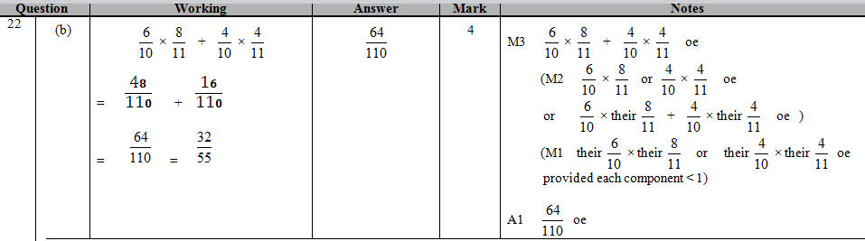
Question 6
?
?
64
110

Slide 13
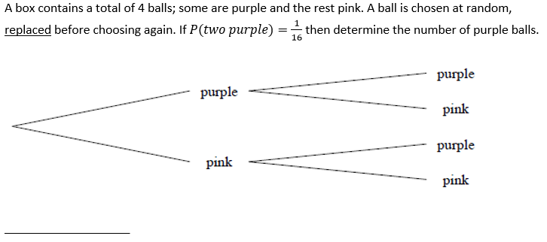



Question 7 (Algebraic Trees)
$$\frac{p}{4}$$
$$\frac{p}{4}$$
?
$$\frac{p}{4}×\frac{p}{4}=\frac{1}{16} \\ \frac{p^{2}}{16}=\frac{1}{16} \\ p^{2}=1 \\ p=1$$

Slide 14
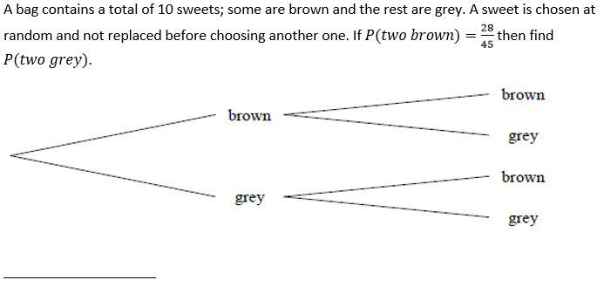


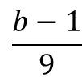
Question 8
$$\frac{b−1}{9}$$
$$\frac{b}{10}$$
?
$$\frac{b}{10}×\frac{b−1}{9}=\frac{b\left(b−1\right)}{90}=\frac{28}{45} \\ b\left(b−1\right)=56 \\ b^{2}−b=56 \\ b^{2}−b−56=0 \\ \left(b+7\right)\left(b−8\right)=0 \\ b=8$$
$$∴P\left(GG\right)=\frac{2}{10}×\frac{1}{9}=\frac{2}{90}=\frac{1}{45}$$

Slide 15
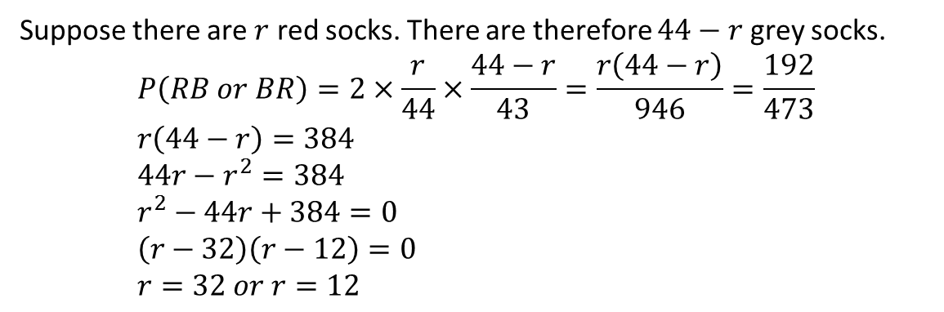
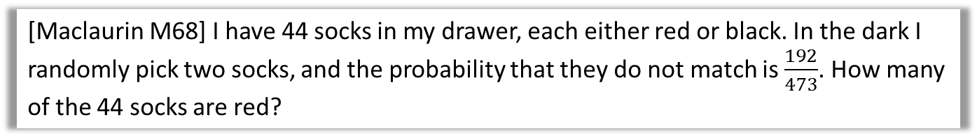
Question N₁
[Maclaurin M68] I have 44 socks in my drawer, each either red or black. In the dark I randomly pick two socks, and the probability that they do not match is $\frac{192}{473}$. How many of the 44 socks are red?
?
Suppose there are $r$ red socks. There are therefore $44−r$ grey socks.
$$P\left(RB or BR\right)=2×\frac{r}{44}×\frac{44−r}{43}=\frac{r\left(44−r\right)}{946}=\frac{192}{473} \\ r\left(44−r\right)=384 \\ 44r−r^{2}=384 \\ r^{2}−44r+384=0 \\ \left(r−32\right)\left(r−12\right)=0 \\ r=32 or r=12$$

Slide 16

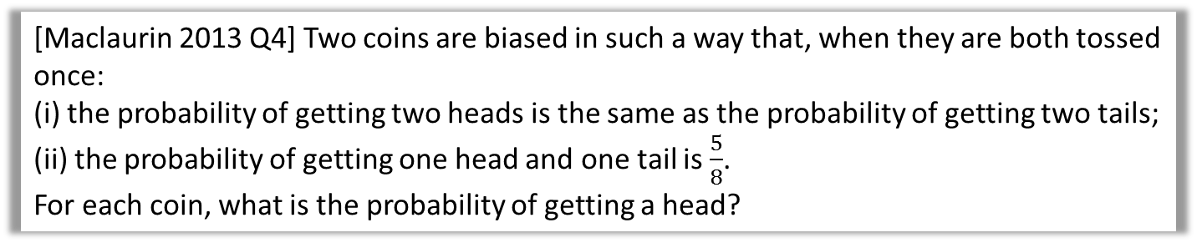
Question N₂
[Maclaurin 2013 Q4] Two coins are biased in such a way that, when they are both tossed once: (i) the probability of getting two heads is the same as the probability of getting two tails; (ii) the probability of getting one head and one tail is $\frac{5}{8}$. For each coin, what is the probability of getting a head?
Let the probability of coin 1 being Heads be $x$ and the probability of coin 2 being Heads $y$.
Then using (i):
$$xy=\left(1−x\right)\left(1−y\right) \\ xy=1−x−y+xy \\ y=1−x$$
Then using (ii):
$$x\left(1−y\right)+y\left(1−x\right)=\frac{5}{8} \\ x−xy+y−xy=\frac{5}{8} \\ 1−2x\left(1−x\right)=\frac{5}{8} \\ 1−2x+{2x}^{2}=\frac{5}{8} \\ 16x^{2}−16x+3=0 \\ \left(4x−1\right)\left(4x−3\right)=0 \\ x=\frac{1}{4} or\frac{3}{4}$$
(and thus the other coin would be $y=\frac{3}{4}$ or $y=\frac{1}{4}$)
?

Slide 17
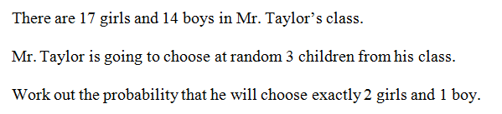

Doing without a tree: Listing outcomes
It’s usually quicker to just list the outcomes rather than draw a tree.
BGG:
GBG:
GGB:
$$\frac{14}{31}×\frac{17}{30}×\frac{16}{29}=\frac{1904}{13485}$$
$$\frac{17}{31}×\frac{14}{30}×\frac{16}{29}=\frac{1904}{13485}$$
$$\frac{17}{31}×\frac{16}{30}×\frac{14}{29}=\frac{1904}{13485}$$
? Working
1904
4495
Answer =
?

Slide 18

Test Your Understanding
Q
I have a bag consisting of 6 red balls, 4 blue and 3 green. I take three balls out of the bag at random. Find the probability that the balls are the same colour. RRR: $\frac{6}{13}×\frac{5}{12}×\frac{4}{11}=\frac{120}{1716}$
GGG: $\frac{3}{13}×\frac{2}{12}×\frac{1}{11}=\frac{6}{1716}$
BBB: $\frac{4}{13}×\frac{3}{12}×\frac{2}{11}=\frac{24}{1716}$
$P\left(same colour\right)=\frac{150}{1716}=\frac{25}{286}$
What’s the probability they’re of different colours:
RGB: $\frac{6}{13}×\frac{4}{12}×\frac{3}{11}=\frac{6}{143}$
Each of the $3!=6$ orderings of RGB will have the same probability.
So $\frac{6}{143}×6=\frac{36}{143}$
?
N
?

Slide 19
Probability Past Paper Questions
Provided on sheet.
Remember:
List the possible events that match.
Find the probability of each (by multiplying).
Add them together.

Slide 20
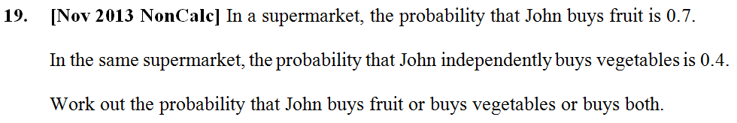
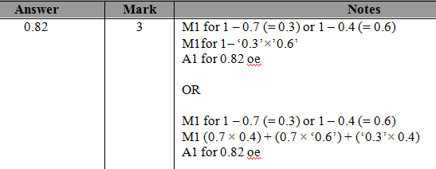
Past Paper Questions
?

Slide 21
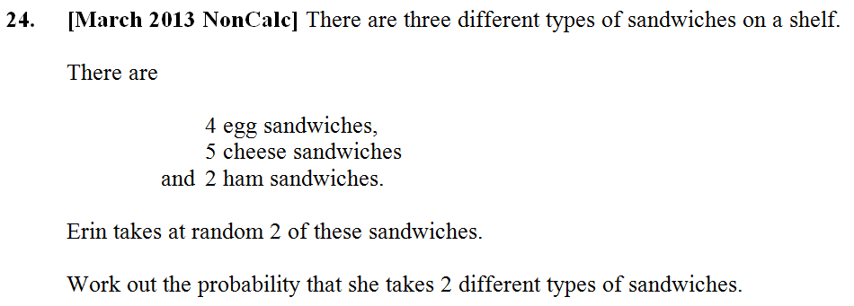
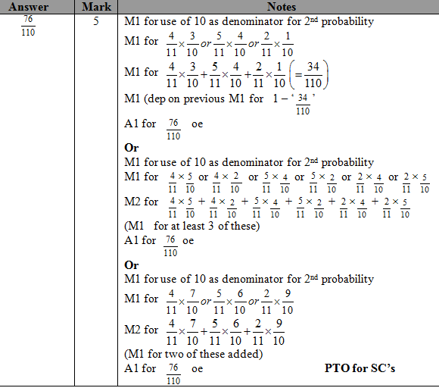
Past Paper Questions
?

Slide 22
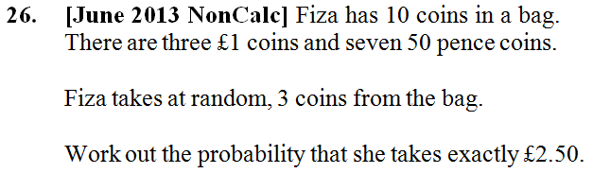
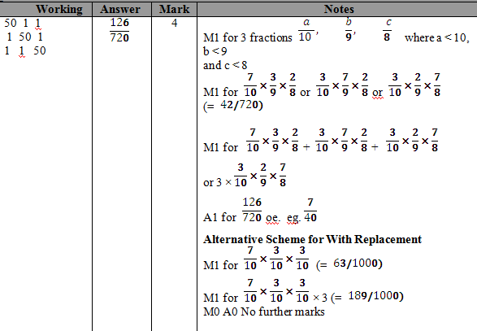
Past Paper Questions
?

Slide 23
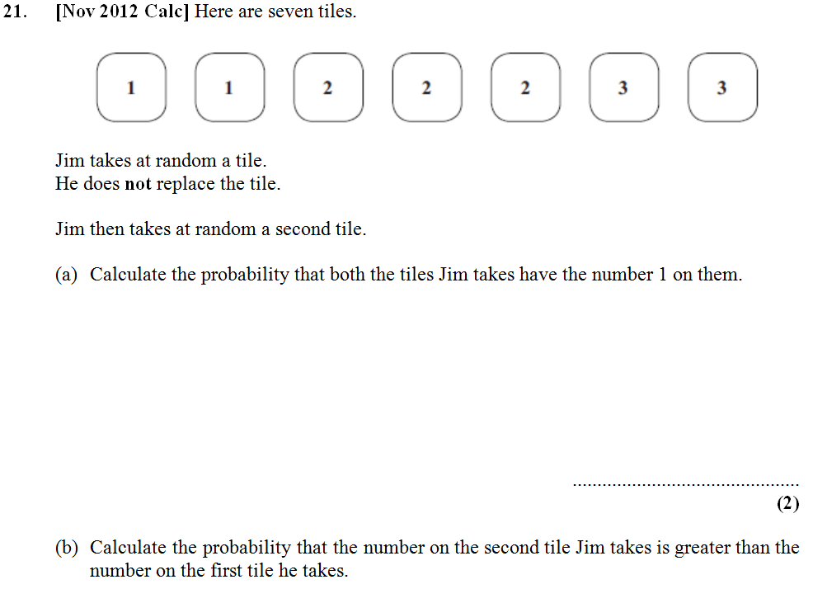
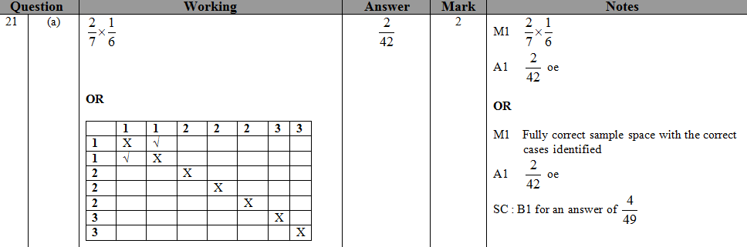
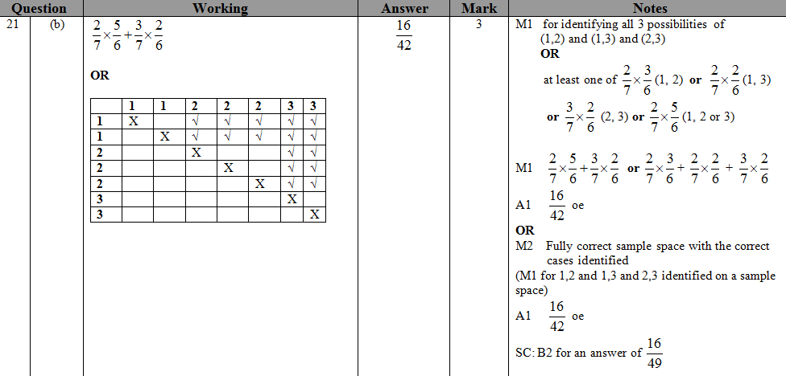
Past Paper Questions
?
2
42
?
16
42

Slide 24
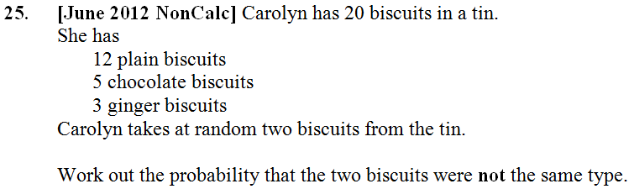
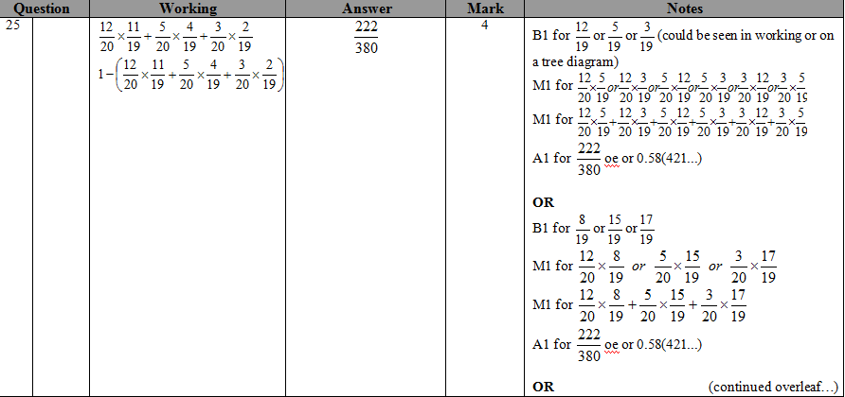
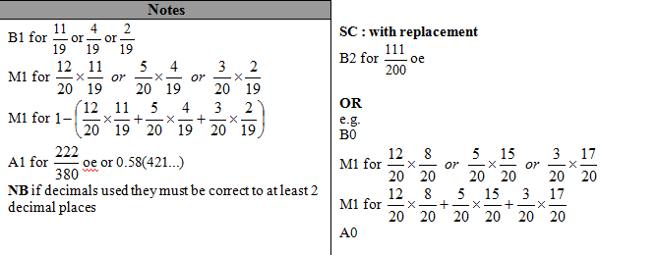
Past Paper Questions
?
222
380

Slide 25
Past Paper Questions
?
?
64
110

Slide 26
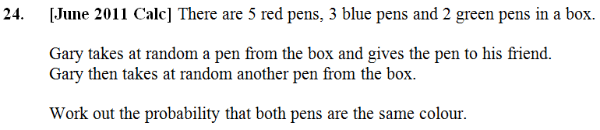
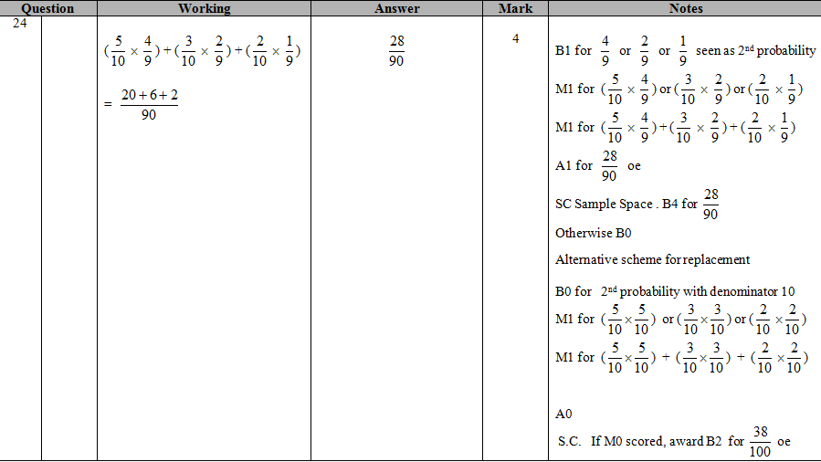
Past Paper Questions
?

Slide 27
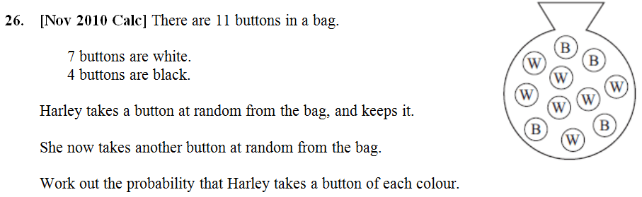

Past Paper Questions
?

Slide 28





RECAP :: Using sets for sample spaces and events
In general, sets are used to represent collections of items.
In probability, an event is a set of one or more outcomes. These are the circles in the Venn Diagram.
We use capital letters for the variables representing sets.
A sample space is set of all possible outcomes. We use $ξ$ (Greek ‘Xi’), or sometimes just $S$, to represent this set. We use a rectangle in a Venn Diagram.
Each number represents an outcome.
$$ξ$$
$E=$“rolling an even number”
$P=$“rolling a prime number”
$$P$$
$$E$$
3
6
2
5
4
1

Slide 29













Combining events/sets
$$ξ$$
$$A$$
$$B$$
$ξ=$ the whole sample space (1 to 6)
$A=$ even number on a die thrown
$B=$ prime number on a die thrown
3
4
1
2
6
5
What does it mean in this context?
What is the resulting set of outcomes?
$$A′$$
?
?
Not A (the “complement” of $A$).
i.e. Not rolling an even number.
$$\{1, 3, 5\}$$
$$A∪B$$
A or B (the “union” of $A$ and $B$). i.e. Rolling an even or prime number.
?
?
$$\{2,3,4,5,6\}$$
$$A∩B$$
A and B (the “intersection” of $A$ and $B$).
i.e. Rolling a number which is even and prime.
?
?
$$\{2\}$$

Slide 30







Some fundamentals
$$ξ$$
$$A$$
$$B$$
$S=$ the whole sample space (1 to 6)
$A=$ even number on a die thrown
$B=$ prime number on a die thrown
3
4
1
2
6
5
What does it mean in this context?
What is the resulting set of outcomes?
$$A∩B′$$
?
?
“A and not B”. Rolling a number which is even and not prime.
$$\{4,6\}$$
$$(A∪B)′$$
?
?
Rolling a number which is not [even or prime].
$$\{1\}$$
$${\left(A∩B\right)}^{′}$$
Rolling a number which is not [even and prime].
?
?
$$\{1,3,4,5,6\}$$

Slide 31





What area is indicated?
$$A$$
$$B$$
$$C$$
$$ξ$$
$$A∩B$$
?

Slide 32

What area is indicated?
$$A$$
$$B$$
$$C$$
$$ξ$$
$$A∪B$$
?

Slide 33

What area is indicated?
$$A$$
$$B$$
$$C$$
$$ξ$$
$$A∩B∩C$$
?

Slide 34

What area is indicated?
$$A$$
$$B$$
$$C$$
$$ξ$$
$$A∩C^{′}$$
?

Slide 35

What area is indicated?
$$A$$
$$B$$
$$C$$
$$ξ$$
$$A∩B∩C^{′}$$
?

Slide 36



What area is indicated?
$$ξ$$
$$A$$
$$B$$
$$C$$
?
?
$$A^{′}∩B^{′}∩C^{′}$$
or
alternatively…
$${\left(A∪B∪C\right)}^{′}$$

Slide 37


What area is indicated?
$$ξ$$
$$A$$
$$B$$
$$C$$
$$A^{′}$$
?

Slide 38


What area is indicated?
$$ξ$$
$$A$$
$$B$$
$$C$$
$$A∩{\left(B∩C\right)}^{′}$$
?

Slide 39


What area is indicated?
$$ξ$$
$$A$$
$$B$$
$$C$$
$$A∩B^{′}∩C′$$
?

Slide 40




Examples
Venn Diagram can either contain:
The specific outcomes in each set
The number of items in the set (i.e. frequencies)
The probability of being in that set.
This will usually be stated or made obvious from the context.
[Textbook] A card is selected at random from a pack of 52 playing cards. Let $A$ be the event that the card is an ace and $D$ the event that the card is a diamond. Find:
$P\left(A∩D\right)$ b) $P\left(A∪D\right)$ c) $P\left(A^{′}\right)$ d) $P\left(A^{′}∩D\right)$
? Venn Diagram
? a
Think “A and D”.
$$P\left(A∩D\right)=\frac{1}{52} \\ P\left(A∪D\right)=\frac{16}{52} \\ P\left(A^{′}\right)=\frac{48}{52} \\ P\left(A^{′}∩D\right)=\frac{12}{52}$$
$$A$$
$$D$$
For union, I visualise this ‘figure-of-8’ shape:
1
? b
3
12
36
? c
? d

Slide 41






Examples
[Textbook] Given that $P\left(A\right)=0.3$, $P\left(B\right)=0.4$ and $P\left(A∩B\right)=0.25$,
Explain why events $A$ and $B$ are not independent.
Given also that $P\left(C\right)=0.2$, that events $A$ and $C$ are mutually exclusive and that events $B$ and $C$ are independent,
b. Draw a Venn diagram to illustrate the events $A, B$ and $C$, showing the probabilities for each region.
c. Find $P\left(\left(A∩B^{′}\right)∪C\right)$
a
$$P\left(A\right)×P\left(B\right)=0.3×0.4=0.12$$
$$P\left(A∩B^{′}\right)=0.05 \\ P\left(\left(A∩B^{′}\right)∪C\right)=0.05+0.2=0.25$$
?
c
?
b
?
$$A$$
$$B$$
$$C$$
0.07
0.05
0.25
0.08
0.12
0.43

Slide 42

Test Your Understanding
May 2013 (R) Q6
Using the above: $0.1=\left(p+0.1\right)×0.4$ $p+0.1=0.25$ $p=0.15$
?
The Venn diagram in Figure 1 shows three events A, B and C and the probabilities associated with each region of B. The constants p, q and r each represent probabilities associated with the three separate regions outside B.
The events A and B are independent.
Find the value of p. (3)

